Slide 1
Week 4 – Lectures 1 and 2
CMSC 508 Database Theory
CMSC 508 – Relational Model
Chapters 2,6 from Database System Concepts, 6th Ed. by Silberschatz, Korth, Sudarshan, 2011 Chapters 3,4 from Database Management Systems, 3rd Ed. by Ramakrishnan, Gehrke, 2003
Notes:
The ER model is a way of modeling the needs of the database that is close to the user/enterprise. It’s a first step at understanding the user requirements and is easy for the end users to understand so it facilitates communication.
Importance of getting the data model right – can change physical design later, but to change the logical design would disrupt the way data is used.
The two major things to avoid are duplication and missing information.

Slide 2
Housekeeping
Still grading Quiz 1
Big SHIFT in Schedule and Outline
See new due dates and deadlines
Creating GITHUB for semester project
Homework due NEXT WEEK Friday, 9/23
nothing due this week

Slide 3


CMSC 508 – Databases
The Relational model
Database design and implementation
Problem
definition
Data modeling
Relational model
Normalization
Implementation
Usage
Information requisites and functional analysis
ER diagram
Tables
Normalized tables
SQL
Interfaces
Resolve

Slide 4
… In Previous episodes …
CMSC 508 – Database Theory
Notes:
"

Slide 5
ACID properties
Atomicity: Either all operations of the transaction are properly reflected in the database or none are
Consistency: Execution of a transaction in isolation preserves the consistency of the database
Isolation: Although multiple transactions may execute concurrently, each transaction must be unaware of other concurrently executing transactions
For every pair of transactions Ti and Tj, it appears to Ti that either Tj, finished execution before Ti started, or Tj started execution after Ti finished
Durability: After a transaction completes successfully, the changes it has made to the database persist, even if there are system failures

Slide 6
CRUD
CRUD – four aspects of the data lifecycle
Create / add / insert data
Read / retrieve / select data
Update / amend / replace data
Delete / remove data
The DBMS will do the ACID work, guaranteeing integrity of the data during any CRUD operations IF YOU TELL IT SO!

Slide 7
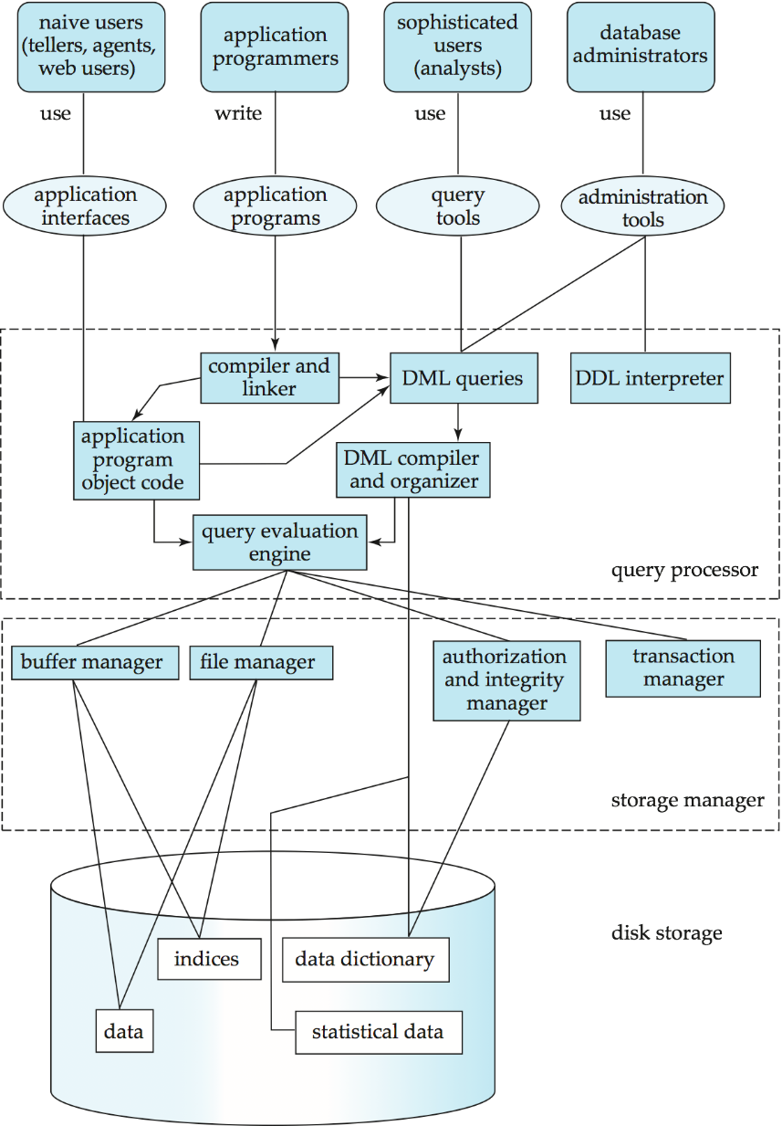
Leveraging the DBMS
What not simply use 2-D arrays or other data structures in our programs? Why use a data base at all?
The DBMS will DO LOTS OF WORK for us AUTOMATICALLY.
We simply need to know how to tell it what we want it to do.
We can provide these management and operating rules when tables are created.
The DBMS will enforce the rules in real-time behind the scenes.
Notes:
An overview of the complexity of a DBMS. This is a general view. A DBMS can take different forms, such as…

Slide 8
The Relational model
… And now back to our regularly schedule program…
CMSC 508 – Database Theory

Slide 9
CMSC 508 – Databases
The Relational model
Relational model
Collection of tables to represent both data and relationships
Tables have columns (attributes) with unique names (order irrelevant)
Tables contain rows (tuples) that correspond to the instances (order irrelevant)
Tables are called relations represented as relationName (ID, Att1, …, AttN)
#Rows = cardinality, #Columns = arity
Columns (schema)
ID | Name | Dept | Salary
45565 | Cano | Comp. Sci. | 75,000.00
98345 | Krawczyk | Comp. Sci. | 80,000.00
76766 | Arodz | Comp. Sci. | 72,000.00
98611 | Doe | Comp. Sci. | 55,000.00
ID | Name | Instructor
CMSC508 | Databases | 45565
CMSC312 | OS | 98345
CMSC401 | Algorithms | 76766
Rows
(tuples)
Course
Instructor

Slide 10

CMSC 508 – Databases
The Relational model
Attribute types
Domain: set of allowed values for each attribute
Attribute values are (normally) required to be atomic (indivisible)
The special value NULL is a member of every domain
The NULL value causes complications in many relational algebra operations
The DB designer must specify whether NULL is allowed or not (NOT NULL)
The DDL specifies the attribute domain
Strings (VARCHAR, CHAR)
Numeric (NUMBER, INTEGER, FLOAT)
Date (DATE, DATETIME)
Objects (BFILE)
0 vs NULL

Slide 11
CMSC 508 – Databases
The Relational model
Relational model
Tables represent both data and relationships
Tables have columns (attributes) with unique names (order irrelevant)
Tables contain rows (tuples) that correspond to the instances (order irrelevant)
Tables are called relations represented as relationName (ID, Att1, …, AttN)
Instructor (ID, Name, Dept, Salary) Course(ID, Name, Instructor)
Attribute names: instructor.id, instructor.name, course.name, course.instructor
#Rows = cardinality, #Columns = arity
Columns (schema)
ID | Name | Instructor
CMSC508 | Databases | 45565
CMSC312 | OS | 98345
CMSC401 | Algorithms | 76766
ID | Name | Dept | Salary
45565 | Cano | Comp. Sci. | 75,000.00
98345 | Krawczyk | Comp. Sci. | 80,000.00
76766 | Arodz | Comp. Sci. | 72,000.00
98611 | Doe | Comp. Sci. | 55,000.00
Rows
(tuples)
Course
Instructor

Slide 12
CMSC 508 – Databases
The Relational model
Integrity constraints
Conditions that must be true for every instance in the relation
Specified in the definition of the logical schema
Checked/verified at every CRUD operation (create, read, update, delete)
Domain integrity:
Data type
Length or size
Negative values
Closed set of allowed values
Is NULL value allowed
Is the value UNIQUE or not for an attribute
Referential integrity: the referenced value must exist when using a foreign key

Slide 13
CMSC 508 – Databases
The Relational model
Keys: Key, Super key, Candidate key, Primary key
A key is a set of attributes uniquely identifying a tuple
A super key is a key of any size
A candidate key is a key of minimal size
A primary key (PK) is selected by the DB designer from one of the candidate keys to become the identifier of the tuples in the relation
Any two tuples in the relation are prohibited from having the same value on the key attributes at the same time
Primary keys are typically size 1 but not necessarily
Every relation (table) must have a primary key
Keys are selected based on the intrinsic definition of the attributes, NOT on the existing values at any point in time

Slide 14
CMSC 508 – Databases
The Relational model
Keys: Key, Super key, Candidate key, Primary key
Relation:
student (V#, SSN, name, address, major)
Relation (detailed):
student (V#: [unique, not null], SSN: [unique, not null], name: [not null], address, major)
Super keys: {V#} , {SSN}, {V#, SSN}, {V#, name}, {SSN, name}, {V#, address}, {SSN, name, major} , … , {V#, SSN, name, address, major}
Candidate keys: {V#}, {SSN} (1-element itemset with minimum size)
Primary key: {V#} or {SSN} (chosen from the candidate keys pool)
Primary keys are by definition unique and not null. Therefore, student becomes:
student (V#: [PK], SSN: [unique, not null], name: [not null], address, major)
Note: PK can be also represented as an underlined attribute(s)

Slide 15
CMSC 508 – Databases
The Relational model
Keys: Foreign key
Foreign key is a column(s) that references another column(s) (usually the primary key of another table but not necessarily)
Use of foreign keys ensures referential integrity of the data, i.e., cannot reference non-existing values in the parent (referenced) table
An attribute in a table can be simultaneously the primary key for that table and a foreign key referencing a column of another table
Attributes which are FKs do not need to have the same name as the referenced
ID | Name | Dept | Salary
45565 | Cano | Comp. Sci. | 75,000.00
98345 | Krawczyk | Comp. Sci. | 80,000.00
76766 | Arodz | Comp. Sci. | 72,000.00
98611 | Doe | Comp. Sci. | 55,000.00
ID | Name | Instructor
CMSC508 | Databases | 45565
CMSC312 | OS | 98345
CMSC401 | Algorithms | 76766
Course
Instructor

Slide 16
CMSC 508 – Databases
The Relational model
Examples
What is the domain of instructor.dept? What is the domain of course.name?
List three super keys of instructor.
List two candidate keys of instructor. What should we use as a primary key? Why:
List two candidate keys for course. What should we use a primary key? Why?
Is there a foreign key in course? If so, what field?
What happens to instructor.id=98345 when we delete course.id=‘CMSC312’ ?
Columns (schema)
ID | Name | Instructor
CMSC508 | Databases | 45565
CMSC312 | OS | 98345
CMSC401 | Algorithms | 76766
ID | Name | Dept | Salary
45565 | Cano | Comp. Sci. | 75,000.00
98345 | Krawczyk | Comp. Sci. | 80,000.00
76766 | Arodz | Comp. Sci. | 72,000.00
98611 | Doe | Comp. Sci. | 55,000.00
Rows
(tuples)
Course
Instructor

Slide 17


CMSC 508 – Databases
The Relational model
Cardinality
Express the number of instances of an entity to which another entity can be associated with via a relationship
Cardinality connectivity
One to one (1:1)
One to many (1:N)
Many to one (N:1)
Many to many (N:N)
Connectors (Crow's Foot Notation)
One
Many

Slide 18




CMSC 508 – Databases
The Relational model
Participation
Express the minimum number of instances of an entity to which another entity can be associated with via a relationship
Total participation means that every entity in the set is involved in the relationship (use must)
Partial participation means that not all entities in the set are involved in the relationship (use may)
Connectors (Crow's Foot Notation)
One
Many
Total
Partial

Slide 19
CMSC 508 – Databases
The Relational model
Examples
Given the relation below, describe the participation of instructor with course.
Given the relational model show below, what is the cardinality of course to instructor?
Does an every instructor need to teach a course?
Can a course have more than one instructor?
How would you modify the relational model to allow more than one instructor per class?
Columns (schema)
ID | Name | Instructor
CMSC508 | Databases | 45565
CMSC312 | OS | 98345
CMSC401 | Algorithms | 76766
ID | Name | Dept | Salary
45565 | Cano | Comp. Sci. | 75,000.00
98345 | Krawczyk | Comp. Sci. | 80,000.00
76766 | Arodz | Comp. Sci. | 72,000.00
98611 | Doe | Comp. Sci. | 55,000.00
Rows
(tuples)
Course
Instructor

Slide 20
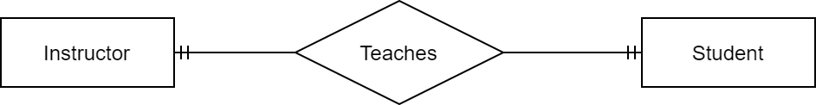
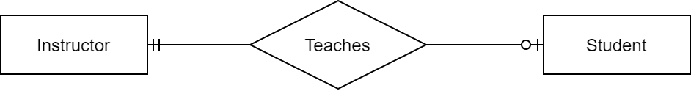
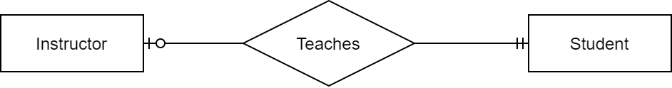

CMSC 508 – Databases
The Relational model
Participation (Crow’s Foot Notation): Cardinality 1:1
Total - total
Partial - total
Total - partial
Partial - partial
An instructor must teach one student A student must be taught by one instructor
An instructor may teach one student A student must be taught by one instructor
An instructor must teach one student A student may be taught by one instructor
An instructor may teach one student A student may be taught by one instructor

Slide 21
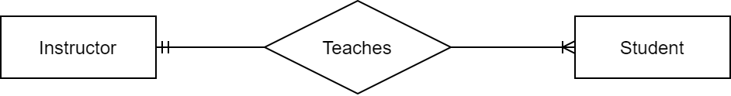
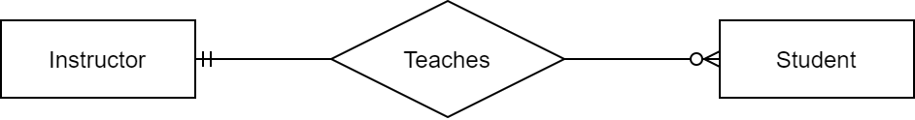
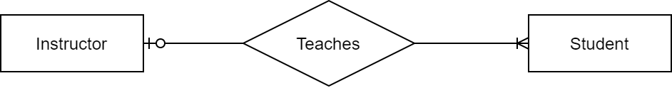

CMSC 508 – Databases
The Relational model
Participation (Crow’s Foot Notation): Cardinality 1:N
Total - total
Partial - total
Total - partial
Partial - partial
Repeat for N:1 and N:N to explore all the cardinality and participation combinations
An instructor must teach one or more A student must be taught by one instructor
An instructor may teach zero or more A student must be taught by one instructor
An instructor must teach one or more A student may be taught by one instructor
An instructor may teach zero or more
A student may be taught by one instructor

Slide 22
CMSC 508 – Databases
The Relational model
Exercises
What’s the ERD representation of Person – Passport?
What’s the meaning (in English) of the following?

Slide 23
An example
CMSC 508 – Database Theory

Slide 24
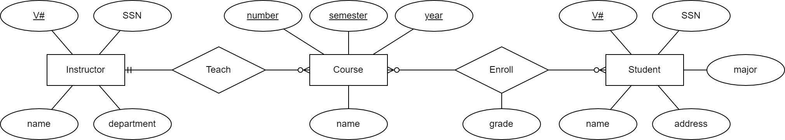
CMSC 508 – Databases
The Relational model
Example
Instructors teach courses and students enroll into courses earning a grade
Entity-Relationship Diagram

Slide 25
For reference - Crow connectors
Mapping of Cardinality and Participation
One
Many
Total
Partial

Slide 26
CMSC 508 – Databases
The Relational model
Example
Instructors teach courses, students enroll into courses and earn a grade
student (V#: [PK], SSN: [unique, not null], name: [not null], address, major)
instructor (V#: [PK], SSN: [unique, not null], name: [not null], department)
V# | SSN | name | address | major
V0123456 | 123-45-6789 | John Doe | NULL | Nuclear Engineering
V0123457 | 234-56-7890 | Homer Simpson | 742 Evergreen Terrace | Nuclear Engineering
V0123458 | 345-67-8901 | Tony Stark | 10880 Malibu Point | Electrical Engineering
V0123459 | 456-78-9012 | Consuela | NULL | NULL
student
V# | SSN | name | department
V9876543 | 567-89-0123 | Alberto Cano | Computer Science
V8765432 | 678-90-1234 | Debra Duke | Computer Science
instructor

Slide 27
CMSC 508 – Databases
The Relational model
Example
instructor (V#: [PK], SSN: [unique, not null], name: [not null], department)
course (number, semester, year, name: [not null], instructor: [not null]) PK {number, semester, year}, FK {instructor} references {instructor.V#}
V# | SSN | name | department
V9876543 | 567-89-0123 | Alberto Cano | Computer Science
V8765432 | 678-90-1234 | Debra Duke | Computer Science
instructor
FKs
number | semester | year | name | instructor
CMSC508 | Fall | 2020 | Databases | V8765432
CMSC508 | Spring | 2021 | Databases | V9876543
course

Slide 28
CMSC 508 – Databases
The Relational model
Example
student (V#: [PK], SSN: [unique, not null], name: [not null], address, major)
course (number, semester, year, name: [not null], instructor: [not null]) PK {number, semester, year}, FK {instructor} references {instructor.V#}
enroll (student, course_number, semester, year, grade) PK {student, course_number, semester, year}, FK {student} references {student.V#}, FK {course_number, semester, year} references {course.number, course.semester, course.year}
student | course_number | semester | year | grade
V0123457 | CMSC508 | Fall | 2020 | A
V0123458 | CMSC508 | Spring | 2021 | B
FK is composite: ALL values must match for the row, NOT each of them separately
enroll

Slide 29
CMSC 508 – Databases
The Relational model
Example: relational model – final solution
student (V#: [PK], SSN: [unique, not null], name: [not null], address, major)
instructor (V#: [PK], SSN: [unique, not null], name: [not null], department)
course (number, semester, year, name: [not null], instructor: [not null]) PK {number, semester, year}, FK {instructor} references {instructor.V#}
enroll (student, course_number, semester, year, grade) PK {student, course_number, semester, year}, FK {student} references {student.V#}, FK {course_number, semester, year} references {course.number, course.semester, course.year}
Can you reconstruct the Entity-Relationship Diagram from the relational model?

Slide 30
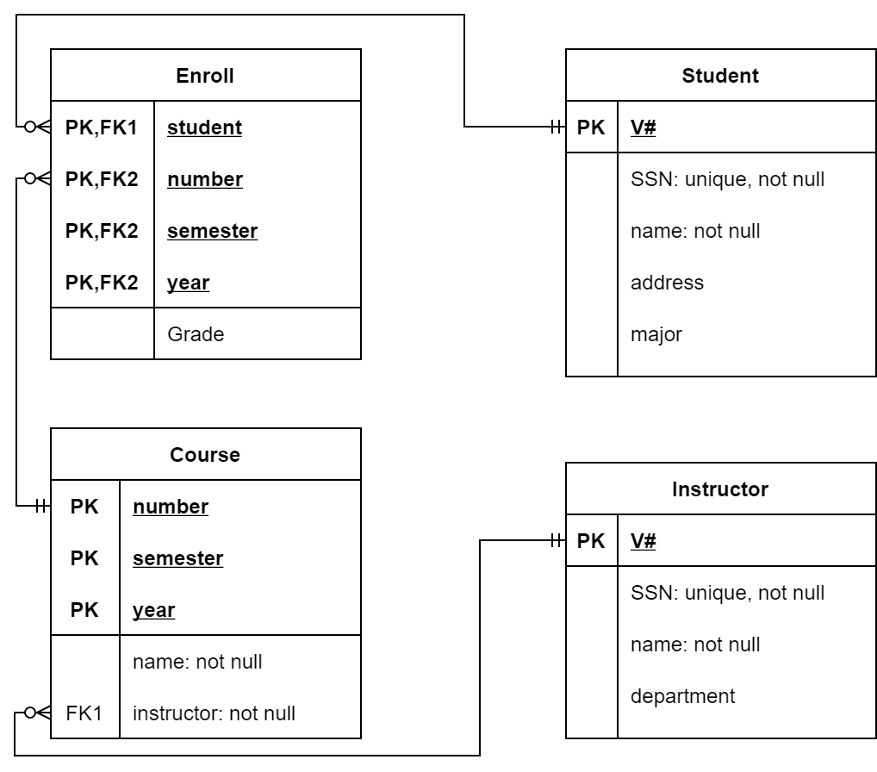
CMSC 508 – Databases
The Relational model
Entity-Relationship Diagram vs Relational Diagram
Entities and relationships
Key attributes
Tables
Primary keys and foreign keys

Slide 31
Translating ERD to Tables
CMSC 508 – Database Theory

Slide 32
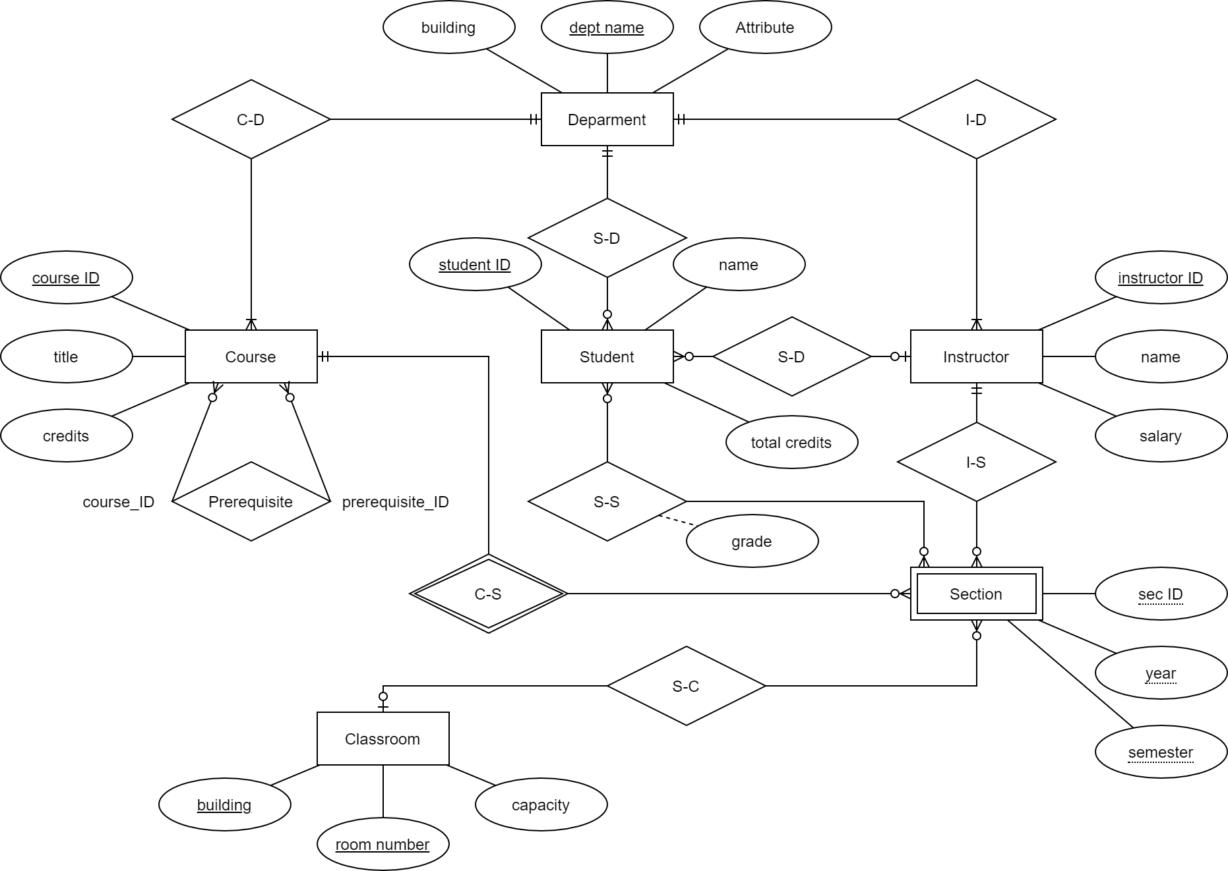
Translation ERD into relational schema
CMSC 508 – Databases
The Relational model
ERD with entities and relationships can be converted into a collection of interrelated relations (tables)
General naive rule: for each entity and relationship there is a unique relation that is assigned the name of the corresponding entity and relationship. However, this will generate many redundancies and may not enforce the cardinality and participation of the relationship
Specific transformation rules depending on the cardinality and participation

Slide 33
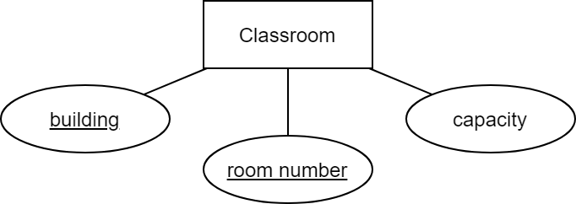
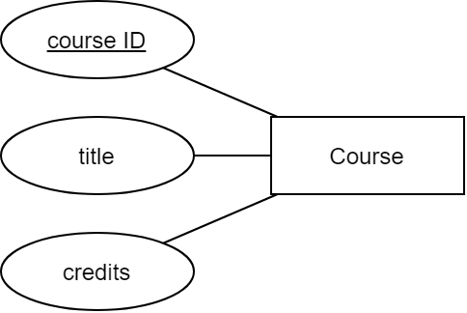
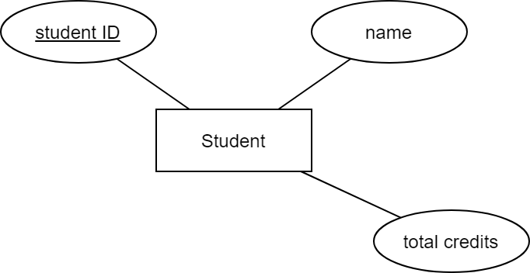
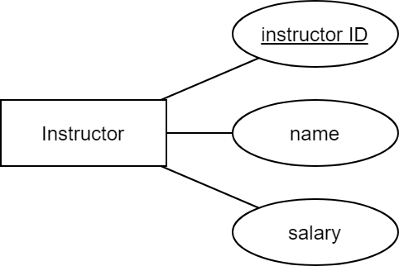
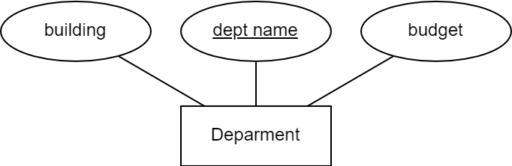
CMSC 508 – Databases
The Relational model
Translation of an ERD into a relational schema
Entities: each relation has columns corresponding to attributes of the entity. Relations always define a primary key using the key attribute(s) of the entity.
1) Entity with atomic attributes
Straightforward transformation into tables:
department (dept_name: [PK], building, budget)
course (ID: [PK], title, credits)
instructor (ID: [PK], name, salary, address)
student (ID: [PK], name, tot_cred)
classroom (building, room_number, capacity) PK {building, room_number}

Slide 34
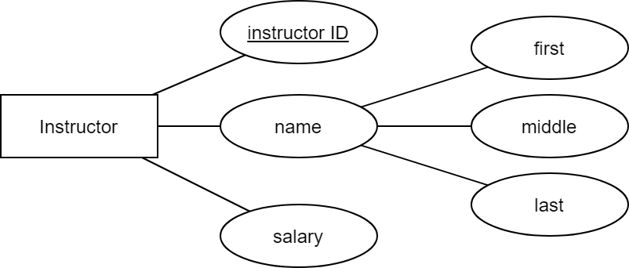
CMSC 508 – Databases
The Relational model
Translation of an ERD into relational schema
Entities: each relation has columns corresponding to attributes of the entity. Relations always define a primary key using the key attribute(s) of the entity.
2) Entity with composite attributes
Decompose composite attributes into atomic
instructor (ID: [PK], name_first, name_middle, name_last, salary)

Slide 35
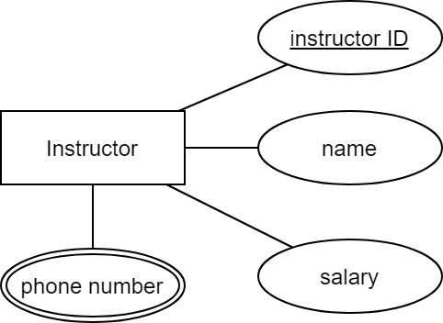
CMSC 508 – Databases
The Relational model
Translation of an ERD into relational schema
Entities: each relation has columns corresponding to attributes of the entity. Relations always define a primary key using the key attribute(s) of the entity.
3) Entity with multi-valued attributes
Create a new table for the multi-valued attribute
instructor (ID: [PK], name, salary)
instructor-phone (instructor, phone_number) PK {instructor, phone_number}, FK {instructor} references {instructor.ID}

Slide 36
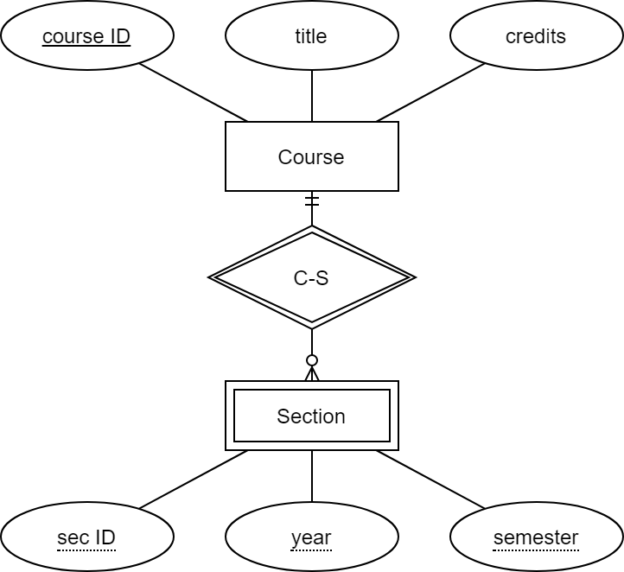
CMSC 508 – Databases
The Relational model
Translation of an ERD into tables
Entities: each relation has columns corresponding to attributes of the entity. Relations always define a primary key using the key attribute(s) of the entity.
4) Representation of a weak entity
Combination of the primary key of the identifying entity and the discriminator attributes of the weak entity serves as the primary key of the table. Foreign keys guarantee referential integrity.
section (course_ID, sec_ID, semester, year) PK {course_ID, sec_ID, semester, year},
FK {course_ID} references {course.ID}

Slide 37

CMSC 508 – Databases
The Relational model
Translation of relationships into the relational model
Relationships can become 1) an attribute in table, 2) a table by themselves
The correct translation will depend on the cardinality and participation
Cardinality: 1:1 vs 1:N vs N:N
Participation: total – total, total – partial, partial – partial
[Critical]: an incorrect translation into tables will change the meaning of the diagram and will introduce redundancy

Slide 38
Detailed examples
CMSC508 – Database Theory

Slide 39
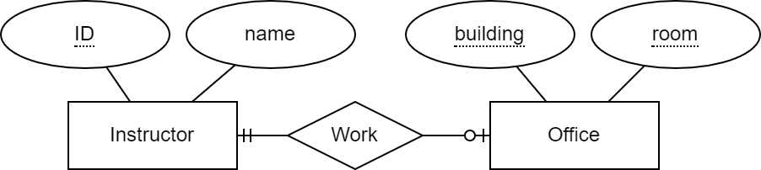
CMSC 508 – Databases
The Relational model
Example 1A
1:1 relationship with total and partial participation
Partial participation of instructor and total of office
Option 1: the partial side incorporates the key from the total side
instructor (ID: [PK], name, building, room) FK {building, room} references {office.building, office.room}
office (building, room) PK {building, room}
ID | name | building | room
V9876543 | Alberto Cano | Engineering | E4251
V8765432 | Debra Duke | NULL | NULL
building | room
Engineering | E4251
Engineering | E4252
Instructor may have an office
Instructor has at most one office
Office must have an instructor
Office has at most one instructor
Nullification
instructor
office

Slide 40
CMSC 508 – Databases
The Relational model
Example 1B
1:1 relationship with total and partial participation
Partial participation of instructor and total of office
Option 2: the total side incorporates the key from the partial side
instructor (ID: [PK], name) office (building, room, instructor: [not null, unique]) PK {building, room}
FK {instructor} references {instructor.ID}
ID | name
V9876543 | Alberto Cano
V8765432 | Debra Duke
building | room | instructor
Engineering | E4251 | V9876543
Engineering | E4252 | V1234567
Instructor may have an office
Instructor has at most one office
Office must have an instructor
Office has at most one instructor
instructor
office

Slide 41
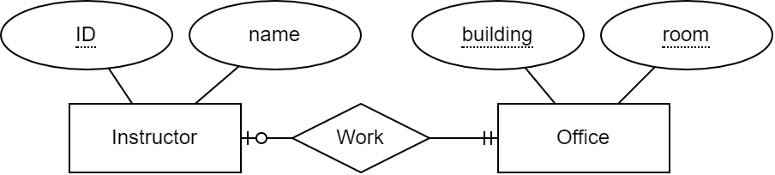
CMSC 508 – Databases
The Relational model
Example 1C
1:1 relationship with total and partial participation
Total participation of instructor and partial of office
The total side incorporates the key from the partial side
instructor (ID: [PK], name, building: [not null], room: [not null]) FK {building, room} references {office.building, office.room} {building, room}: [unique]
office (building, room) PK {building, room}
ID | name | building | room
V9876543 | Alberto Cano | Engineering | E4251
V8765432 | Debra Duke | Engineering | E4252
building | room
Engineering | E4251
Engineering | E4252
Instructor must have an office
Instructor has at most one office
Office may have an instructor
Office has at most one instructor
instructor
office

Slide 42
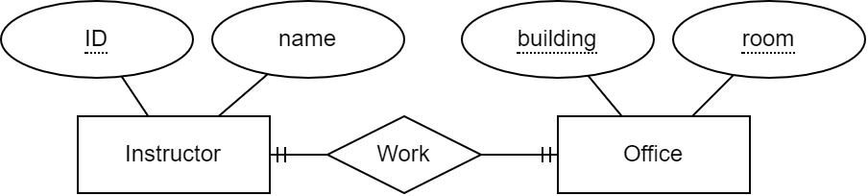
CMSC 508 – Databases
The Relational model
Example 1D
1:1 relationship with total and total participation
Total participation of instructor and total of office
Each side incorporates the other side’s keys
instructor (ID: [PK], name, building: [not null], room: [not null]) FK {building, room} references {office.building, office.room} {building, room}: [unique]
office (building, room, instructor: [not null, unique]) PK {building, room}
FK {instructor} references {instructor.ID}
Instructor must have an office
Instructor has at most one office
Office must have an instructor
Office has at most one instructor
Redundancy
ID | name | building | room
V9876543 | Alberto Cano | Engineering | E4251
V8765432 | Debra Duke | Engineering | E4252
building | room | instructor
Engineering | E4251 | V9876543
Engineering | E4252 | V1234567
instructor
office

Slide 43
CMSC 508 – Databases
The Relational model
Example 1E
1:1 relationship with total and total participation
Total participation of instructor and total of office
Merge the two tables into one (any of the two PKs is now the key)
Instructor-office (ID: [PK], name, building: [not null], room: [not null]) {building, room}: [unique]
ID | name | building | room
V9876543 | Alberto Cano | Engineering | E4251
V8765432 | Debra Duke | Engineering | E4252
Instructor must have an office
Instructor has at most one office
Office must have an instructor
Office has at most one instructor
Normalization (later)
Instructor-office

Slide 44

CMSC 508 – Databases
The Relational model
Example 1F
1:1 relationship with partial and partial participation
Partial participation of instructor and partial of office
Option 1: one partial side incorporates the key from the other partial side
instructor (ID: [PK], name, building, room) FK {building, room} references {office.building, office.room} {building, room}: [unique]
office (building, room) PK {building, room}
ID | name | building | room
V9876543 | Alberto Cano | Engineering | E4251
V8765432 | Debra Duke | NULL | NULL
building | room
Engineering | E4251
Engineering | E4252
Instructor may have an office
Instructor has at most one office
Office may have an instructor
Office has at most one instructor
Nullification (no matter which side)
instructor
office

Slide 45
CMSC 508 – Databases
The Relational model
Example 1G
1:1 relationship with partial and partial participation
Partial participation of instructor and partial of office
Option 2: create a separate table (one side’s key becomes PK, other side’s key unique)
instructor (ID: [PK], name) office (building, room) PK {building, room}
instructor-office (instructor, building, room) PK {instructor}, FK {building, room} references {office.building, office.room} {building, room}: [unique]
Instructor may have an office
Instructor has at most one office
Office may have an instructor
Office has at most one instructor
ID | name
V9876543 | Alberto Cano
V8765432 | Debra Duke
building | room
Engineering | E4251
Engineering | E4252
instructor | building | room
V9876543 | Engineering | E4251
instructor
office
Instructor-office

Slide 46
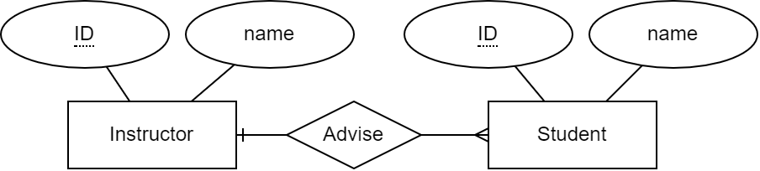
CMSC 508 – Databases
The Relational model
Example 2A
1:N relationships
Total participation on many side difficult to model
Total participation on the one side may be enforced using advisor: [not null]
Option 1: The many side incorporates the key from the one side as FK
instructor (ID: [PK], name) student (ID: [PK], name, advisor)
FK {advisor} references {instructor.ID}
ID | name
V9876543 | Alberto Cano
V8765432 | Debra Duke
ID | name | advisor
V0123456 | John Doe | V9876543
V0123457 | Homer Simpson | NULL
Instructor may advise none/many students
Instructor must advise at least one
Student may/must be advised
Student has at most one advisor
Nullification (depending on % participation)
instructor
student

Slide 47
CMSC 508 – Databases
The Relational model
Example 2B
1:N relationships
Only OK to avoid nullification if relationship is sparse
Breaks the total participation of the one side
Option 2: create a separate table
instructor (ID: [PK], name) student (ID: [PK], name)
advise (instructor, student)
PK {student} FK {instructor} references {instructor.ID}, FK student references {student.ID}
ID | name
V9876543 | Alberto Cano
V8765432 | Debra Duke
ID | name
V0123456 | John Doe
V0123457 | Homer Simpson
instructor | student
V9876543 | V0123456
Instructor may advise none/many students
Instructor must advise at least one
Student may be advised
Student must be advised (new problem!)
Student hast at most one advisor
instructor
student
advise

Slide 48

CMSC 508 – Databases
The Relational model
Example 2C
N:N relationships
Easy! But total participation cannot be enforced
Create a separate table incorporating the respective keys and they all become the PK
instructor (ID: [PK], name) student (ID: [PK], name)
advise (instructor, student)
PK {instructor, student} FK {instructor} references {instructor.ID}, FK student references {student.ID}
ID | name
V9876543 | Alberto Cano
V8765432 | Debra Duke
ID | name
V0123456 | John Doe
V0123457 | Homer Simpson
instructor | student
V9876543 | V0123456
V8765432 | V0123456
Instructor may advise none/many students
Instructor must advise at least one
Student may be advised by none/many
Student must be advised at least one
instructor
student
advise

Slide 49
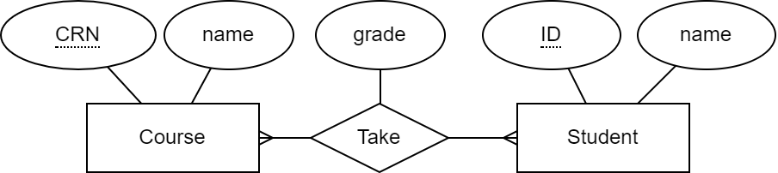
CMSC 508 – Databases
The Relational model
Example 3
N:N relationships
Attributes in the relationship
Create a separate table incorporating the respective keys and they both become the PK
course (CRN: [PK], name) student (ID: [PK], name)
enroll (student, course, grade)
PK {student, course} FK {course} references {course.CRN}, FK student references {student.ID}
student | course | grade
V0123456 | 3354640 | A
V0123457 | 3354640 | B
V0123457 | 4648941 | C
CRN | name
3354640 | Databases
4648941 | Op. Systems
ID | name
V0123456 | John Doe
V0123457 | Homer Simpson
What if student fails and must retake?
course
student
enroll

Slide 50
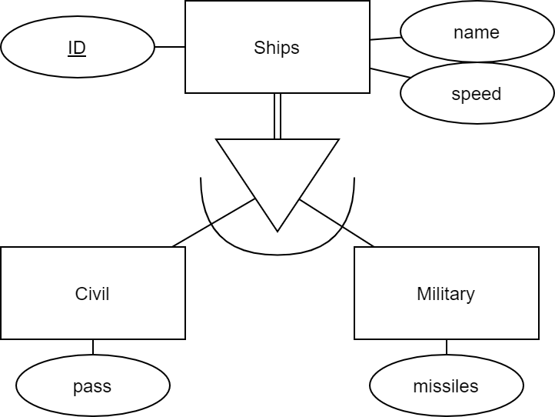
CMSC 508 – Databases
The Relational model
Example 4A - Translation of specialization
Form a schema for the higher-level entity with the common attributes
Form a schema for each lower-level entity, include the primary key of the higher-level entity as a foreign key and append the respective attributes
ship (ID: [PK], name, speed) ship-civil (ID: [PK], passengers)
FK {ID} references {ship.ID}
ship-military (ID: [PK], missiles)
FK {ID} references {ship.ID}
ID | name | speed
123 | X-wing | 1.35
456 | Millennium Falcon | 1.66
ID | passengers
456 | 5
ID | missiles
123 | 8
How about the intersectability and participation?
ship
ship-civil
ship-military

Slide 51
CMSC 508 – Databases
The Relational model
Example 4B - Translation of specialization: intersectability and participation
Disjoint: add a column to the higher-level for the type (enforce not null if total)
Overlapping: nothing explicitly needed
ship (ID: [PK], name, speed, type: [not null]) ship-civil (ID: [PK], passengers)
FK {ID} references {ship.ID}
ship-military (ID: [PK], missiles)
FK {ID} references {ship.ID}
ID | name | speed | type
123 | X-wing | 1.35 | military
456 | Millennium Falcon | 1.66 | civil
ID | passengers
456 | 5
ID | missiles
123 | 8
ship
ship-civil
ship-military

Slide 52
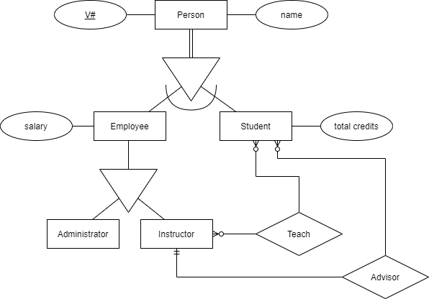
CMSC 508 – Databases
The Relational model
Example 5 - Translation of specialization (Example)
person (V#: [PK], name, type: [not null]) employee (V#: [PK], salary) FK {V#} references {person.V#}
administrator (V#: [PK]) FK {V#} references {employee.V#}
instructor (V#: [PK]) FK {V#} references {employee.V#}
student (V#: [PK], tot_credits, advisor: [not null]) FK {V#} references {person.V#} FK {advisor} references {instructor.V#}
teach (instructor, student) PK {instructor, student} FK {instructor} references {instructor.V#} FK {student} references {student.V#}

Slide 53
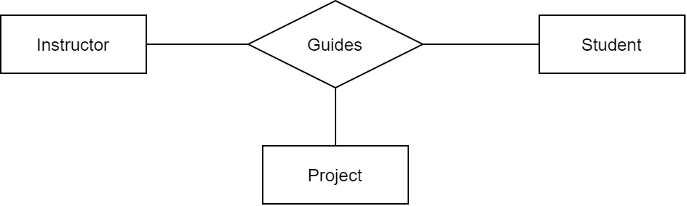
CMSC 508 – Databases
The Relational model
Example 6 - Translation of n-ary relationships
The n-ary relationship becomes a new relation
instructor (V#: [PK])
student (V#: [PK])
project (ID: [PK], title)
guides (instructor, student, project)
PK {instructor, student, project}
FK {instructor} references {instructor.V#}
FK {student} references {student.V#}
FK {project} references {project.ID}
instructor | student | project
V9876543 | V0123456 | 1234
V8765432 | V0123456 | 4567
guides

Slide 54
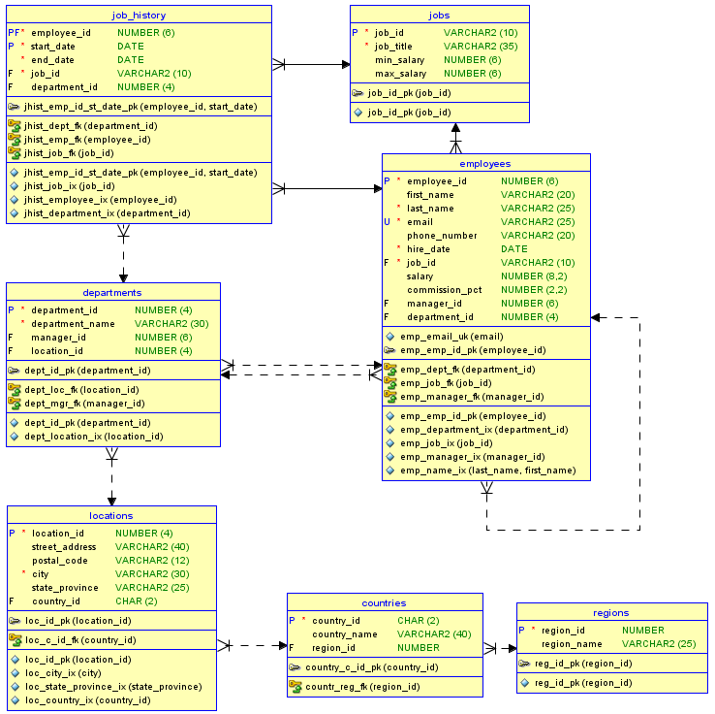
CMSC 508 – Databases
The Relational model
Real-world visualization of a relational diagram
We’ll use this DB for MySQL
Physical view: it contains all details about datatypes and tables
Software tools may help to translate the ERD into relations
Software tools can create the relational diagram from the SQL tables directly
Two-way road: ERD <–> RD <-> SQL Traceability!!

Slide 55

CMSC 508 – Databases
The Relational model
Exercise: Translate the ERD into the relational model
List the tables, attributes, constraints, and keys
Draw the relational diagram

Slide 56
CMSC 508 – Databases
The Relational model
Summary
The relational data model is based on a collection of tables (relations)
The schema refers to the logical design, the instance refers to its contents
The schema includes attributes, types of the attributes, and constraints
A key is a set of attributes guaranteed to identify tuples uniquely
A superkey is a key of any size
A candidate key is a minimal superkey
The primary key is one of the candidate keys selected by the DB designer
A foreign key is a set of attributes referencing attributes in another table
A relational diagram shows the relations, attributes, and keys
Rules for translating an ERD into tables according to the cardinality and participation

Slide 57
CMSC 508 – Databases
The Relational model
Review terms
Table
Relation
Tuple
Attribute
Domain
Atomic
NULL value
UNIQUE value
Nullification
Database schema
Database instance
Schema
Instance
Keys
Superkey
Candidate key
Primary key
Foreign key
Domain integrity
Referential integrity
Relational diagram

